Slide 1
Internal rate of return

Slide 2
Introduction
The IRR is defined as the discount rate that forces the NPV to be zero.

Slide 3
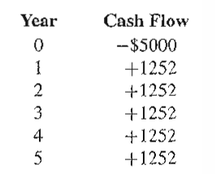
Example
If a Rs.5000 is invested on a machine with a 5 year useful life and an equivalent uniform annual benefits of Rs. 1252, then the cash flows is as shown below,
An appropriate question is, What rate of return would we receive on this investment?

Slide 4
Types of Rate of Return
Rate of return is the percentage that indicates the relative yield on different uses of capital.
Following rate of returns are frequently used,
The minimum acceptable rate of return (MARR)
Lowest level of return at which the investment is acceptable.
The limit is set by individuals or organizations.
It ensures the best possible use of limited resources.

Slide 5
The Internal Rate of Return (IRR)
It is the rate on the unrecovered balance of the investment where the terminal balance is zero.
External Rate of Return (ERR)
It is the possible rate of return for an investment under current economic conditions

Slide 6
To Summarize
IRR is the return which a proposal is fetching based on the cash inflows and outflows (i.e. at Present worth of costs = present worth of benefits).
MARR is the opportunity what an organization have to earn if the money is not invested in the new proposal.
Return expected based on the prevailing economic conditions.

Slide 7
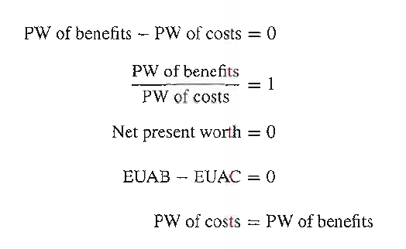
Procedure
To calculate rate of return on an investment, we must convert the various consequences of the investment into cash flow.
Then will solve the cash flow for unknown value of internal rate of return (IRR).
Five forms of cash flow equations are as follows:

Slide 8
SINGLE SIMPLE INVESTMENT
An $8200 investment returned $2000 per year over a 5-year useful life. What was the rate of return on the investment?

Slide 9
West Texas Oil has paid Rs.300000 for producing oil well. Field engineers estimate that net receipts will be Rs.120000 for the first year of operation, with a reduction amount of 15 percent of the first year payment, for every year thereafter till the end of five years. It plans to sell well after 5 years for Rs. 80000. how does this seem financially if their MARR is 20%?

Slide 10
A patch of land adjacent to the proposed international airport is likely to increase in value. The cost of land now is INR 8,00,000 and is expected to be worth INR 15,00,000 within 5 years. During this period it can be rented for small scale industry at INR 15000 per year. Annual taxes are presently is INR 8500 and likely to remain constant. What rate of return will be earned on the investment if the estimates are accurate?

Slide 11
Incremental Cash Flow Analysis
Under some circumstances, project ROR values do not provide the same ranking of alternatives as do PW, AW, and FW analyses. This situation does not occur if we conduct an incremental cash flow ROR analysis.

Slide 12
Comparing Mutually Exclusive Alternatives Based on IRR
Issue: Can we rank the mutually exclusive projects by the magnitude of its IRR?
Incremental analysis can be defined as the examination of the differences between alternatives.
By emphasizing alternatives, we are really deciding whether or not differential costs are justified by differential benefits.
n A1 A2
0
1
IRR
-$1,000 -$5,000
$2,000 $7,000
100% > 40%
$818 < $1,364
PW (10%)

Slide 13

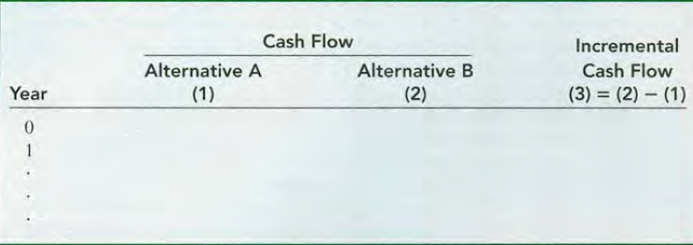
Convention
Only for the purpose of simplification, use the convention that between two alternatives, the one with the larger initial investment will be regarded as alternative B.

Slide 14
General Types of Incremental IRR Numerical
The initial investment and annual cash flows for each alternative (excluding the salvage value) occur in one of two patterns:
Revenue alternative, where there are both negative and positive cash flows.
Service alternative, where all cash flow estimates are negative.

Slide 15
For MARR of 6% and each alternative having a life of 20 years with no salvage value and cost information as shown in table below,
Which Alternative is preferred? Use Incremental IRR method.
 | A | B | C
Initial Costs, $ | 2000 | 4000 | 5000
Uniform annual benefit, $/year | 410 | 639 | 700

Slide 16
 | A | B | C
Initial Costs, $ | 2000 | 4000 | 5000
Uniform annual benefit, $/year | 410 | 639 | 700
Step 1: Calculate IRR for each Alternative Individually

Slide 17
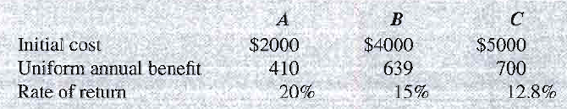
Since all IRR > MARR, None of the Alternative is Rejected.
Now Carrying out Incremental IRR between the 3 Alternatives

Slide 18
 | A | B | C
Initial Costs, $ | 2000 | 4000 | 5000
Uniform annual benefit, $/year | 410 | 639 | 700
Step 2: Arranging the Selected Alternatives in Ascending Order of Initial Cost,
Performing the Incremental IRR analysis between the first two (pair) alternatives and the selected one is considered for the next iteration, this continues till the last alternative

Slide 19
In 2000, Bell Atlantic and GTE merged to form a giant telecommunications corporation named Verizon Communications. As expected, some equipment incompatibilities had to be rectified, especially for long distance and international wireless and video services. One item had two suppliers-a U.S. firm (A) and an Asian firm (B). Approximately 3000 units of this equipment were needed. Estimates for vendors A and B are given for each unit. Determine which vendor should be selected if the MARR is 15% per year.
 | A | B
Initial Cost, $ | -8000 | -13000
Annual Cost, $ | -3500 | -1600
Salvage Value, $ | 0 | 2000
Life, Years | 10 | 5

